Slide 1

MMAI 5000 N
05/06/2024
PROJECT
Proposal
Priya Chaudhuri
Xiaoxia Chen
Akriti Saklani
D. Yuke
ID: 220819488
Ayres
Rahik Hasan
ID: 221060736
ID: 220988267
ID:221043682
ID: 221048350
ID: 221104138

Slide 2
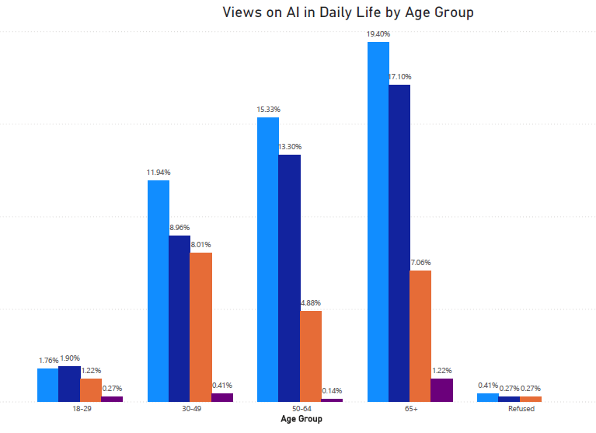
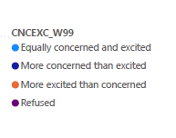
MMAI 500 S
05/05/2024
Problem Statement
X BMS Corporation
Identifying key demographic trends in AI and Biomedical Sciences (BMS), with a focus on chip implants (to improve process efficiency) and gene editing (to enhance health outcomes). By analyzing data from Pew Research across various demographic factors such as age, gender, education, race, and income, the project will help X BMS Corp. make informed decisions about market positioning for a new BMS product.

Slide 3
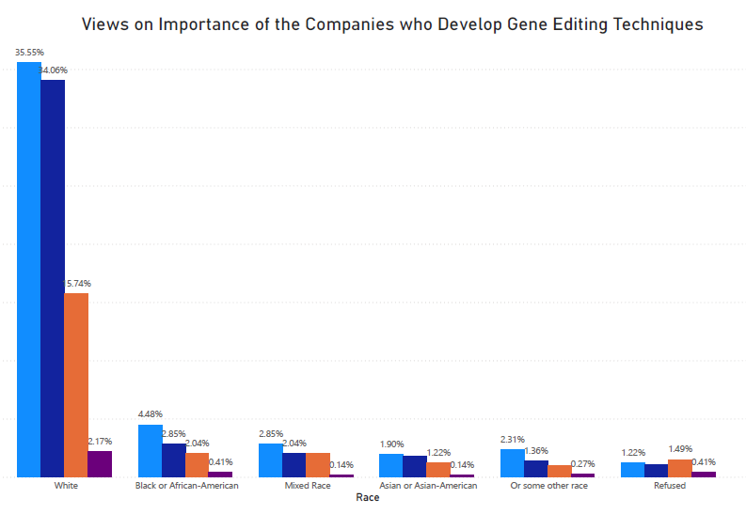
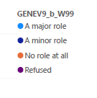
Objective
The project will provide critical support for X BMS Corp. by informing strategic decisions in targeting and marketing efforts to enhance the market presence and ensure the successful launch and adoption of the new BMS product. Specifically:
Demographic Trends
Optimize Market Positioning
Support Decision Making
Analyze Pew Research data to uncover trends among various demographic groups (age, gender, education, race, income) related to awareness and acceptance of AI and BMS technologies, particularly chip implants and gene editing.
Use insights from the demographic analysis to guide X BMS Corp. in positioning the new BMS product effectively within the market.
Provide actionable data that helps X BMS Corp. make informed decisions regarding product development, marketing, and distribution.

Slide 4
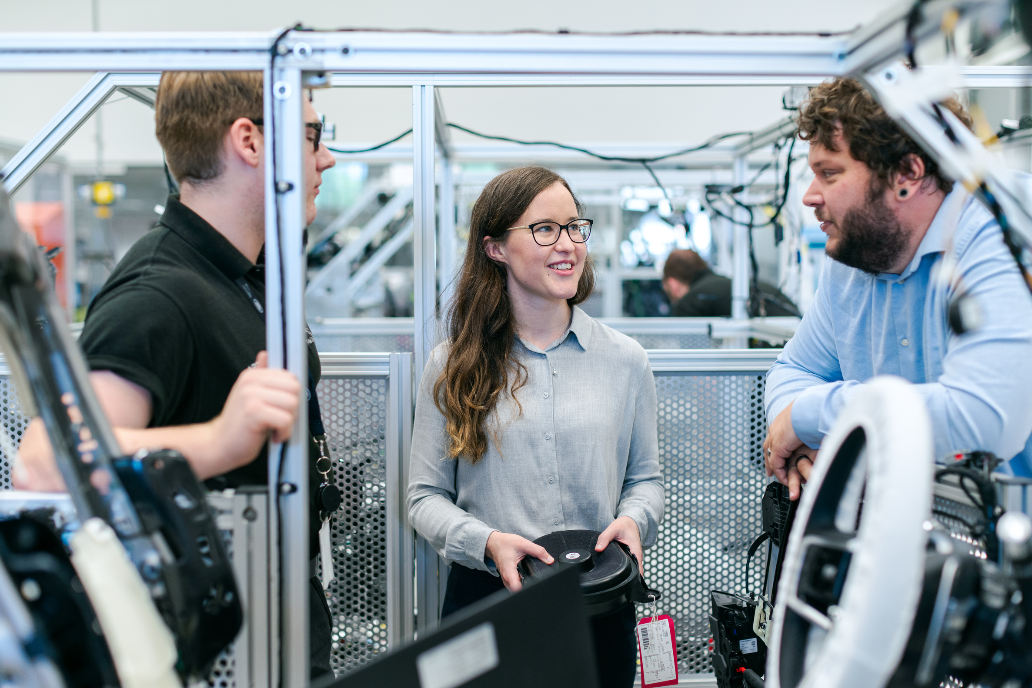
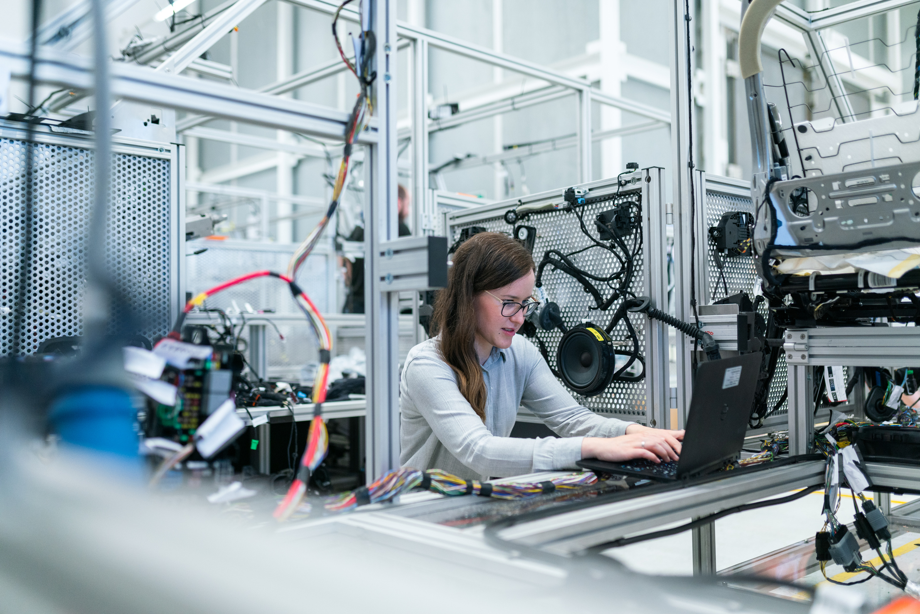
External
Environment
Technological Progress
AI integration in biomedical devices, specifically chip implants, has advanced precision medicine and personalized healthcare.
The market is increasingly open to AI-integrated chip implants as technology improves.
X BMS Corp. can leverage this trend by introducing innovative solutions for enhanced medical outcomes.
When launching a new AI/BMS product like chip implants or gene editing technologies, it's important to consider external environmental factors that could impact the project's success. We would be solely focusing on the Technological Progress and the Ethical & Social Environment, impacting the project.
Ethical and Social Environment
People worry about “designer babies” and the potential impact on human diversity
Beliefs play a role in accepting or rejecting gene editing technologies
Limited access to gene editing could worsen existing social inequalities.

Slide 5

Data Cleaning
Missing Value Treatment
Data Transformation
Identify missing values with data.isnull().sum()
Handle missing values by dropping rows (data.dropna())
Remove irrelevant columns with data.drop(columns, axis=1, inplace=True)
Divide the whole dataset based on the technologies taken up from our project
Duplicate & Anomaly
Validation
While the dataset provides valuable insights into demographic characteristics and technology engagement, certain limitations and challenges, such as missing data, need to be addressed during the analysis process.
Strategies for handling missing data, ensuring data quality, and transforming data should be implemented to maintain the integrity and reliability of the findings.
Detect duplicate rows
Identify and handle any remaining anomalies or inconsistencies
Maintain a log or documentation of data cleaning steps.
Create a copy of the cleaned dataset with the to_excel() feature

Slide 6

Next Steps
Analyze
Perform further analysis (correlation, trends, segmentation) on the dataset to extract actionable insights for strategic decision-making at X BMS Corp.
Integrate
Integrate external research and market analysis findings to enhance understanding of external factors impacting technology adoption and market dynamics.
Collaborate
Collaborate with domain experts and stakeholders to validate findings, refine strategies, and ensure alignment with organizational objectives and market prospects.

Slide 7

Thank You

